Slide 1
Vehicle Rental System
A Capstone Project for NucleusTeq Training
Presented by: Ishika Sadhwani

Slide 2
Project Overview
• A web-based platform for renting vehicles.
• Users can browse and book vehicles.
• Admins can manage users, vehicles, and bookings.
• Ensures a seamless rental experience.

Slide 3
Technology Stack
• Frontend: HTML, CSS, JavaScript
• Backend: Spring Boot 3.3.10
• Database: PostgreSQL
• Tools: IntelliJ IDEA, Git, Postman

Slide 4
Features & Functionalities
• User Features: Browse vehicles, book rentals, view bookings
• Admin Features: Manage users, vehicles, bookings

Slide 5
System Architecture
User (Browser) → Spring Boot Backend → PostgreSQL Database
(Handles UI) (Processes Requests) (Stores Data)

Slide 6
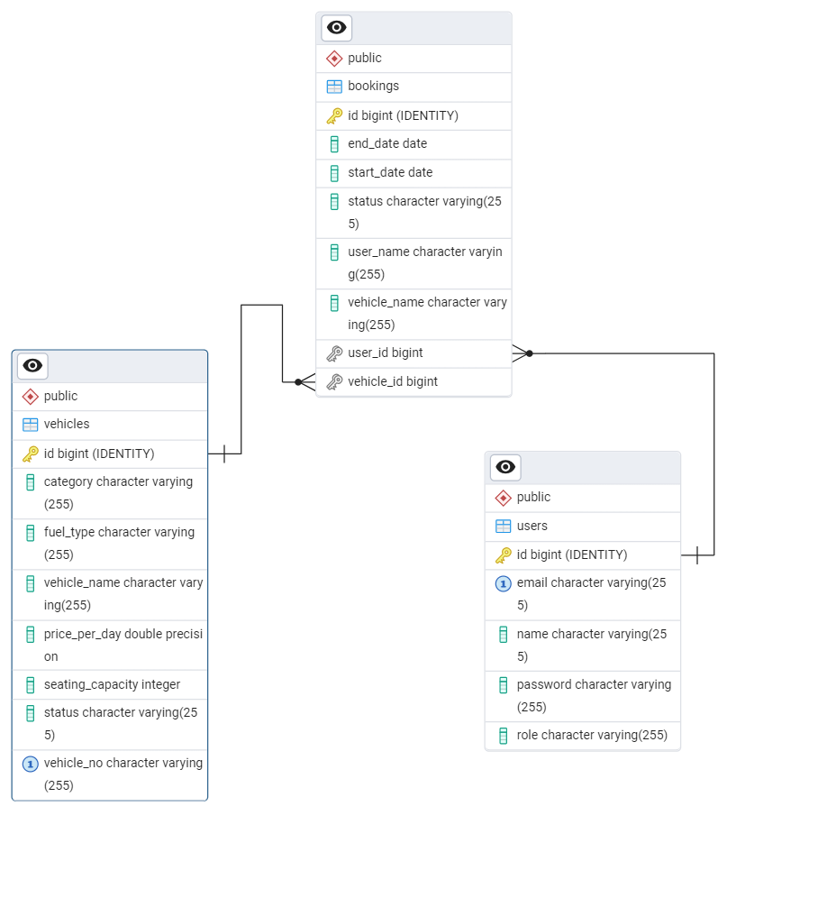
ER Diagram

Slide 7
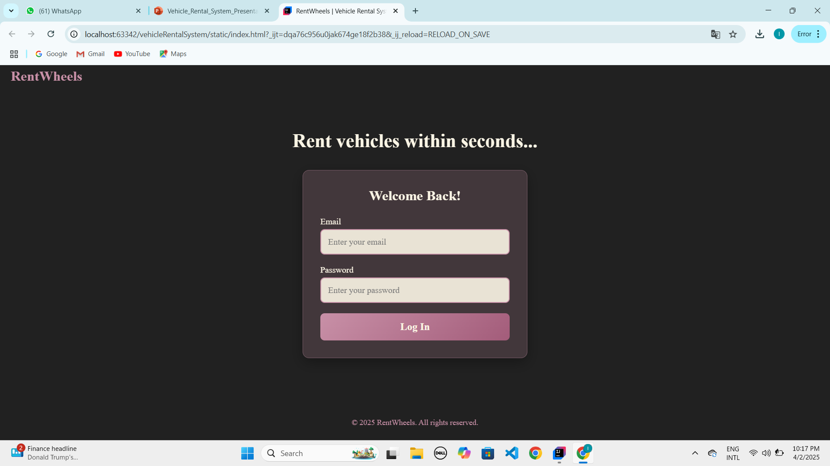

Slide 8
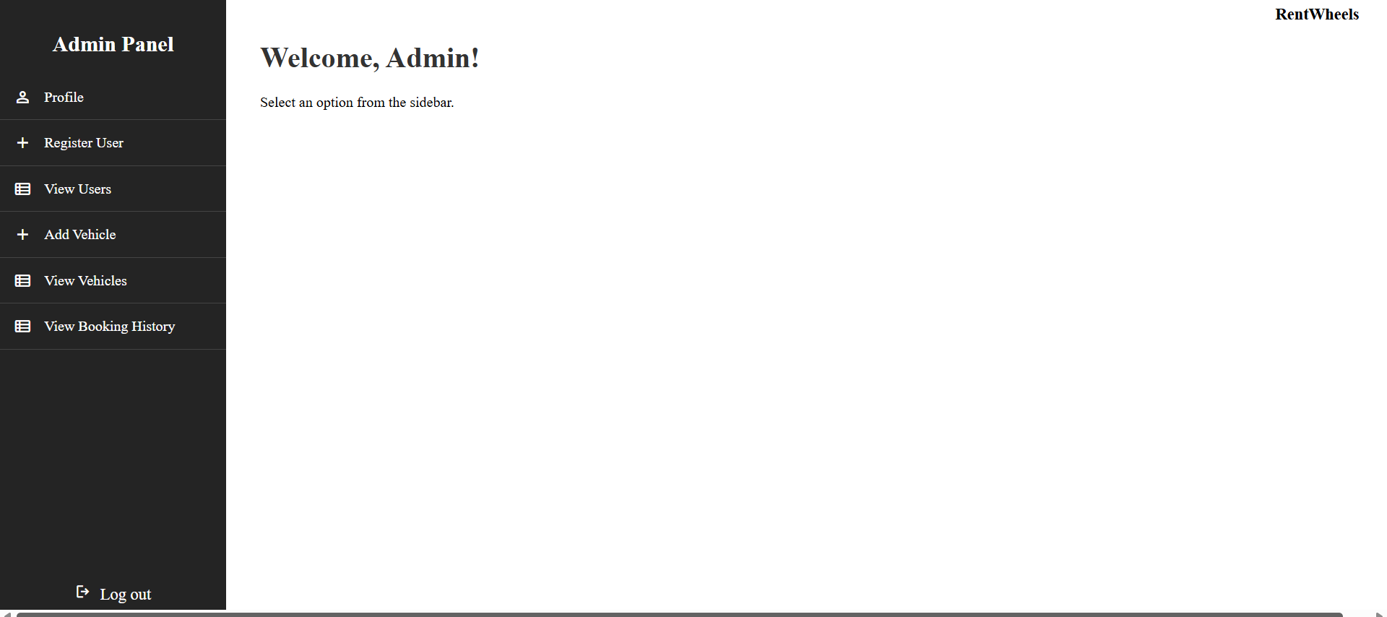

Slide 9
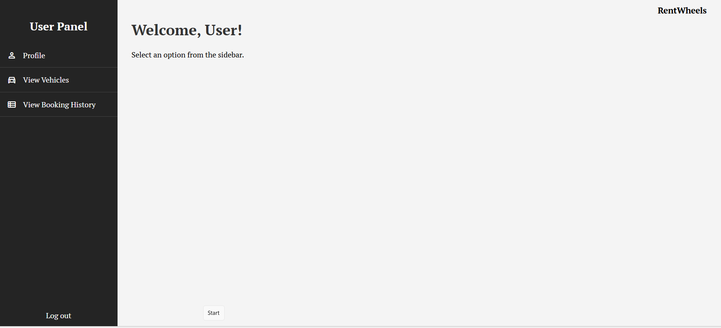

Slide 10
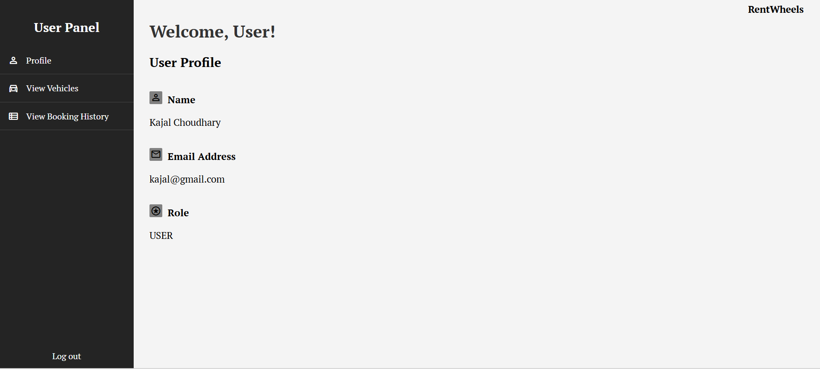

Slide 11
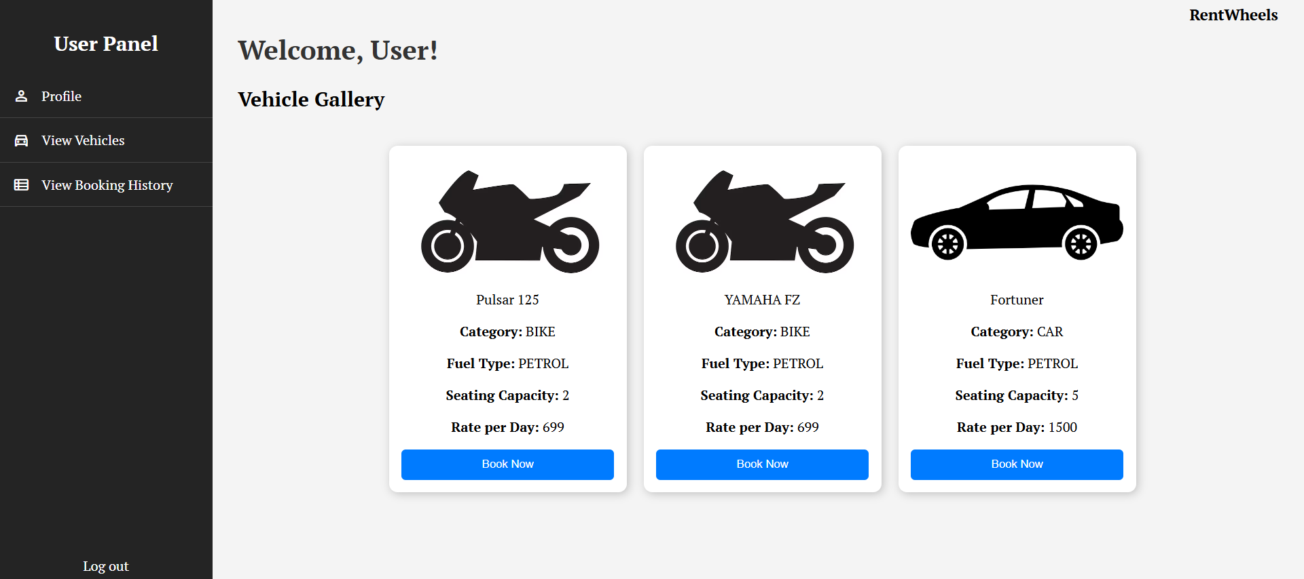

Slide 12
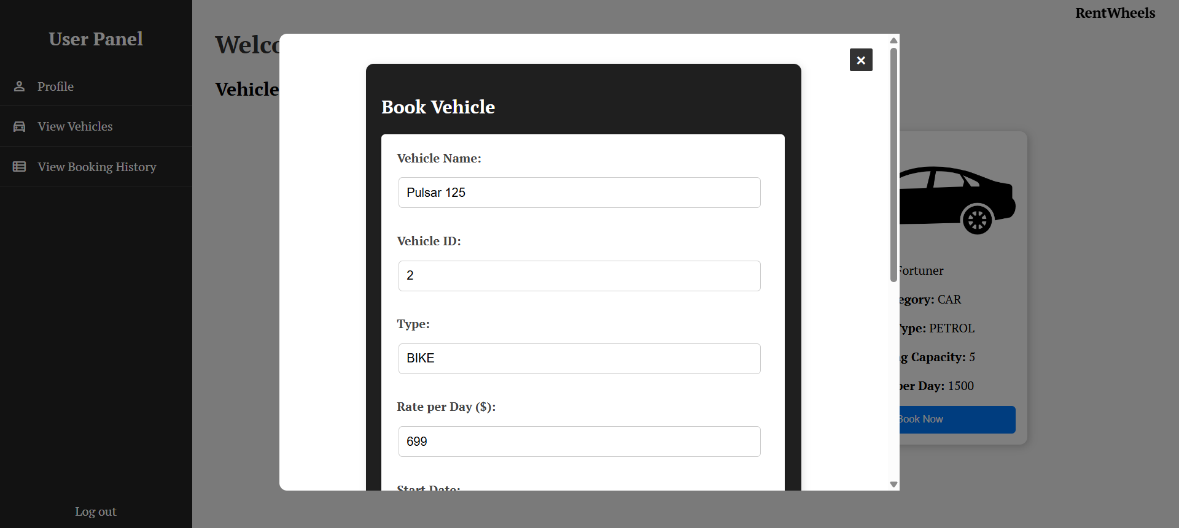

Slide 13
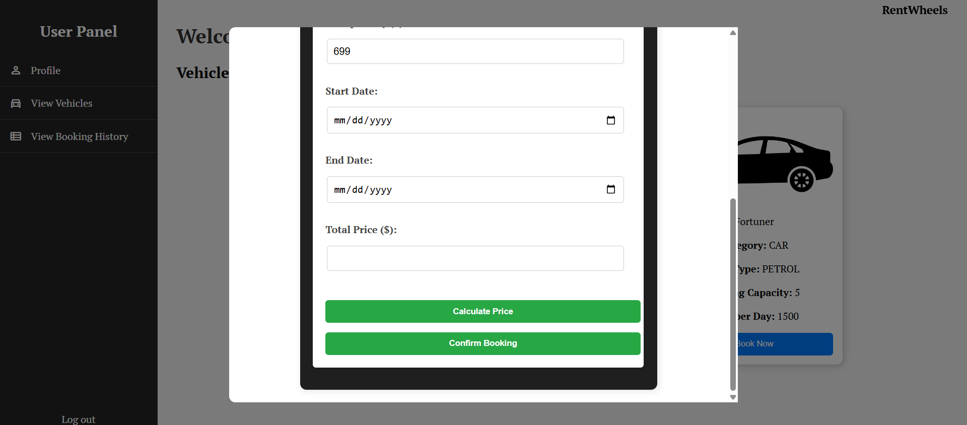

Slide 14
Future Enhancements & Conclusion
• Potential additions: Ratings & Reviews, Booking recommendations.
• Improved UI/UX for better user experience.
• Final thoughts: A structured system for efficient vehicle rental management

Slide 15
Thank you!

